Slide 1
Project Introduction
Exploring 5G and Virtualization in broadcast production

Slide 2
Background
Live content
Broadcasters
Consumers
Create more content with fewer resources
Notes:
The Media & Entertainment (M&E) industry has been undergoing fundamental changes in recent years, largely as a result of the change in the viewing habits of consumers who now have a huge the choice for entertainment.
In this highly competitive environment, broadcasters and content producers must meet growing consumer demand for ever more engaging content, in particular by using more live sources and trying to get live feedback from the audience straight into the production chain. The big challenge for them is that they need to produce more content, at time when they have less time and fewer resources to do so, in many cases using a network infrastructure based on technology (SDI - Serial Digital Interface) that is 30 years old and not suited for the Internet and mobile age.

Slide 3
Purpose
Live Broadcast Production
Broadcasters
Consumers
5G technology
Virtualization concepts
Notes:
The purpose of the EU project VIRTUOSA is to explore through real-life examples how 5G wireless communication can be combined with virtualization concepts from the IT industry to enable broadcasters to produce live content (such as sports or music coverage) more efficiently and cost-effectively across locations, to meet growing consumer demand.

Slide 4
Official title
Scalable Software Defined Network Architectures
for Cooperative LIVE Media Production
exploiting Virtualized Production Resources
and 5G Wireless Acquisition
Notes:
The official title of the VIRTUOSA project is:
Scalable Software Defined Network Architectures for Cooperative LIVE Media Production exploiting Virtualized Production Resources and 5G Wireless Acquisition

Slide 5
Participants
Notes:
The VIRTUOSA project is run by a consortium of 4 organizations:
Nevion AS (Norway) - Nevion provides media network and broadcast infrastructure solutions to broadcasters, telecommunication service providers, government agencies and other industries.
Mellanox Technologies LTD (Israel) - Mellanox Technologies is a leading supplier of end-to-end Ethernet and InfiniBand intelligent interconnect solutions and services for servers, storage, and hyper-converged infrastructure.
LOGIC media solutions GmbH (Germany) - LOGIC is a German-based media infrastructure architect and distributor of professional broadcast and telecommunication equipment.
Institut für Rundfunktechnik GmbH (Germany) - The IRT is a world-renowned research and innovation center for broadcasting and media technology with more than 0 years of experience.

Slide 6
EU funding
€ 2 million funding from the European Union’s Horizon 2020 research and innovation program under grant agreement No 866656.
Notes:
The VIRTUOSA project has received € 2 million funding from the European Union’s Horizon 2020 research and innovation program under grant agreement No 866656.

Slide 7
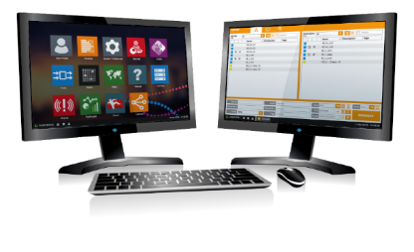
Solution
IP LAN
Software for Media Network Management & Orchestration Software
IP WAN
Tailor-made Software-Defined Media Network Architecture
SDN-based
Media Servers
& Media Routers (ethernet/IP Switches)
5G
Notes:
The overall objective of the 24-month VIRTUOSA project is to create a market ready product - the VIRTUOSA product (or solution) - fully tested technically, validated in a real operational environment.
The product itself will be based on three core technical elements:
Architecture: a tailor-made architecture solution for SDN-based LAN & WAN and 5G acquisition
Equipment: high performance SDN-based media servers and media routers (Ethernet/IP switches)
Software: media network management and self-service orchestration.

Slide 8
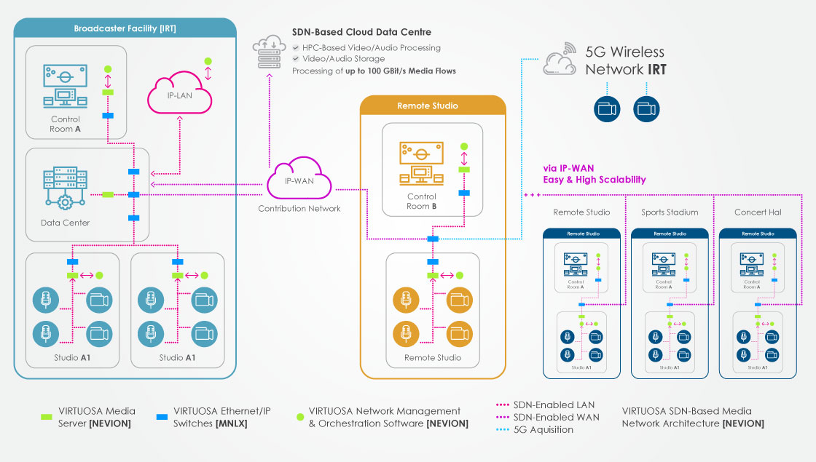
Notes:
The plan for project VIRTUOSA is to build a real-life live production set-up combining broadcast facilities and remote studios connected by IP networks (both LAN and WAN), combined with remote live contributions from cameras connected via a 5G network.
The solution will involve products from Nevion and Mellanox, as well as 3rd party equipment from various companies, sourced by IRT and LOGIC media.

Slide 9
1
+
2
+
4
+
24
=
Project
€ million
EU funding
Participants
Months
=
Revolutionizing live broadcast production!

Slide 10
Thank you!
info@5g-virtuosa.eu

